Slide 1
Chapter 1: Fundamental Principles of Counting
謝孫源 講座教授
hsiehsy@mail.ntcku.edu.tw
國立成功大學 資訊工程系

Slide 2
Outline
The Rules of Sum and Product
Permutations
Combinations: The Binomial Theorem
Combinations with Repetition

Slide 3
The Rules of Sum (1/2)
The Rule of Sum: If a first task can be performed in m ways, while a second task can be performed in n ways, and the two tasks cannot be performed simultaneously, then performing either task can be accomplished in any one of
m + n ways.

Slide 4
The Rules of Sum (2/2)
Example 1.1: A college library has 40 textbooks on sociology and 50 textbooks dealing with anthropology. By the rule of sum, a student at this college can select among 40 + 50 = 90 textbooks in order to learn more about one or the other of these two subjects.
Notes:
Anthropology: 人類學

Slide 5
The Rules of Product (1/2)
The Rule of Product: If a procedure can be broken down into first and second stages, and if there are m possible outcomes for the first stage and if, for each of these outcomes, there are n possible outcomes for the second stage, then the total procedure can be carried out, in the designated order, in mn ways.

Slide 6
The Rules of Product (2/2)
Example 1.6: Considering the manufacture of license plates consisting of 2 letters followed by 4 digits.
  If no letter or digit can be repeated, there are
  26 × 25 × 10 × 9 × 8 × 7 = 3,276,000 different possible plates.
  With repetitions of letters and digits allowed,
  26 × 26 × 10 × 10 × 10 × 10 = 6,760,000 different license plates are possible.
  If repetitions are allowed, as in part (b), how many of the plates have only vowels (A, E, I, O, U) and even digits? (0 is an even integer.)
Notes:
5 × 5 × 5 × 5 × 5 × 5 = 15,625

Slide 7
The Rules of Sum and Product
Example 1.8: At the AWL corporation Mrs. Foster operates the Quick Snake Coffee Shop. The menu at her shop is limited: 6 kinds of muffins, 8 kinds of sandwiches, and 5 beverages (hot coffee, hot tea, iced tea, cola, and orange juice). Ms. Dodd, an editor at AWL, sends her assistant Carl to the shop to get her lunch – either a muffin and a hot beverage or a sandwich and a cold beverage. How many ways in which Carl can purchase Ms. Dodd’s lunch?
6 × 2 + 8 × 3 = 12 + 24 = 36
Notes:
Muffin:鬆餅

Slide 8
Outline
The Rules of Sum and Product
Permutations
Combinations: The Binomial Theorem
Combinations with Repetition

Slide 9

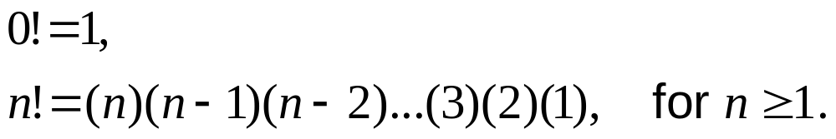
Permutations (1/2)
Example 1.9: In a class of 10 students, 5 are to be chosen and seated in a row for a picture. How many such linear arrangements are possible?
10 × 9 × 8 × 7 × 6 = 30,240
Definition 1.1: For an integer , n factorial (denoted n!) is defined by

Slide 10
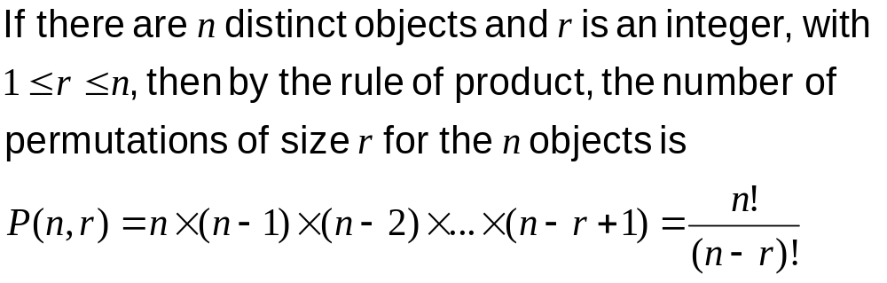
Permutations (2/2)
Definition 1.2: Given a collection of n distinct objects, any (linear) arrangement of these objects is called a permutation of the collection.

Slide 11
Permutations with Indistinguishable Objects (1/2)
Example 1.12: Consider the arrangements of all 9 letters in DATABASES.
(2!)(3!)(Number of arrangements of the letters in DATABASES) = (Number of permutations of the symbols D, A₁, T, A₂, B, A₃, S₁, E, S₂)
9!/(2!3!) = 30,240

Slide 12
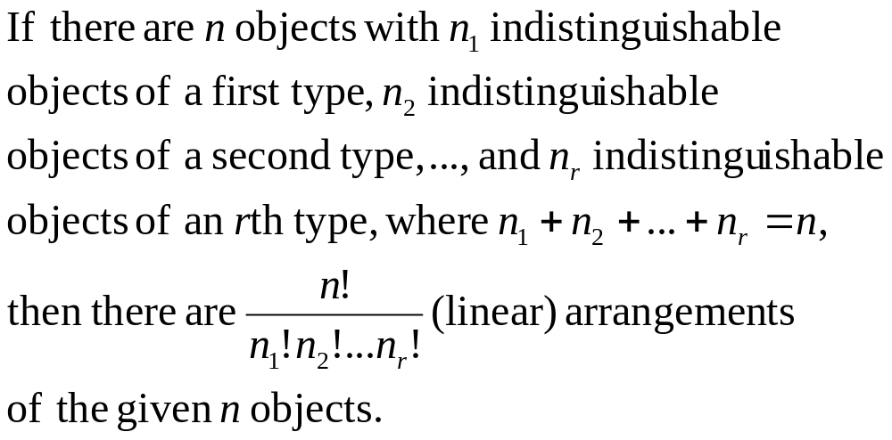
Permutations with Indistinguishable Objects (2/2)

Slide 13

Examples (1/2)
Example 1.14: Determine the number of (staircase) paths in the xy-plane from (2, 1) to
(7, 4), where each such path is made up of individual steps going one unit to the right (R) or one unit upward (U).
(Figure Here!)
8!/(5!3!) = 56

Slide 14
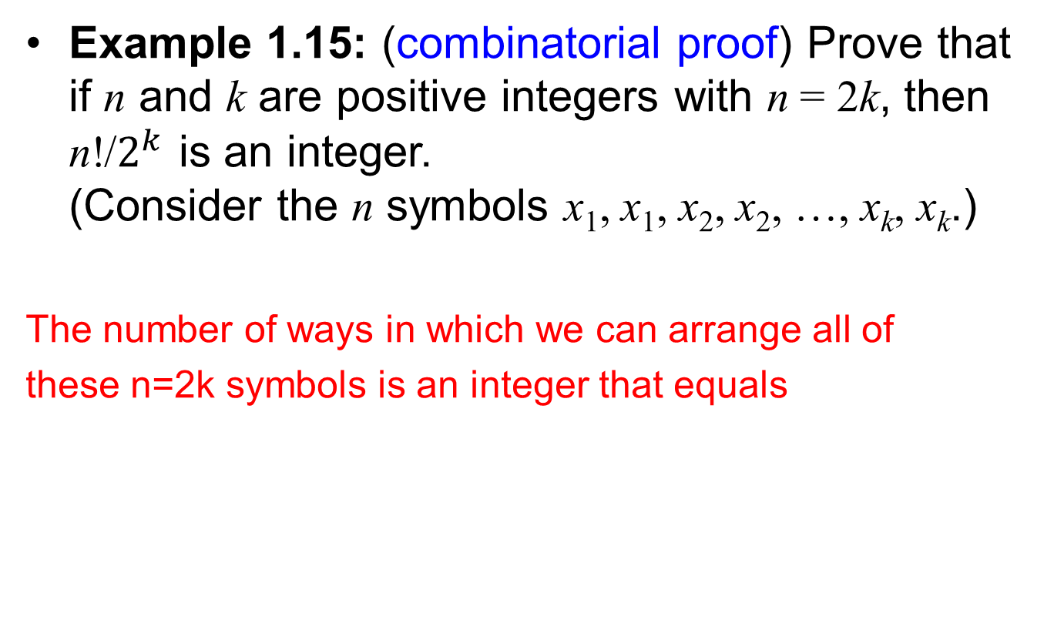
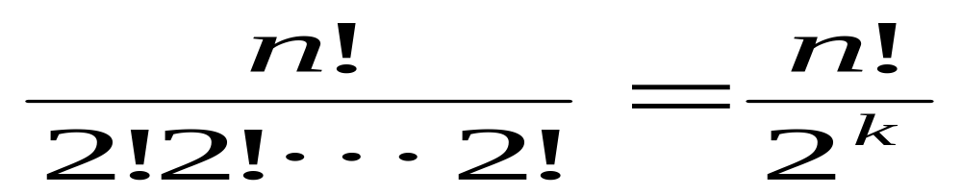
Examples (2/2)

Slide 15
Nonlinear Arrangement (1/2)
Example 1.16: If 6 people, designated as A, B, …, F, are seated about a round table, how many different circular arrangements are possible, if arrangements are considered the same when one can be obtained from the other by rotation?
There are 6!/6 = 5! = 120 arrangements.

Slide 16
Nonlinear Arrangement (2/2)
Example 1.17: Suppose now the 6 people of Example 1.16 are 3 married couples and that A, B, and C are the females. We want to arrange the 6 people around the table so that the sexes alternate. (Once again, arrangements are considered identical if one can be obtained from the other by rotation.)
3 × 2 × 2 × 1 × 1 = 12 ways
Notes:
固定A, 男的有三種選擇, 接下來女的有兩種選擇, …

Slide 17
Outline
The Rules of Sum and Product
Permutations
Combinations: The Binomial Theorem
Combinations with Repetition

Slide 18
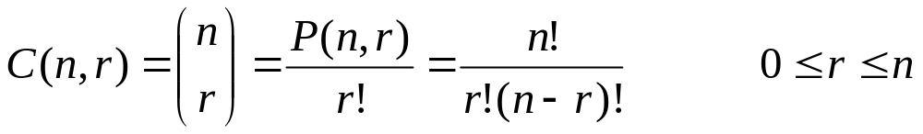
Combinations: The Binomial Theorem
If we start with n distinct objects, each selection, or combination, of r of these objects, with no reference to order, corresponds to r! permutations of size r from the n objects. Thus the number of combinations of size r from a collection of size n is
Notes:
C(n, r) read “n choose r”

Slide 19
Combination Examples (1/2)
Example 1.19: Lynn and Patti decide to buy a PowerBall ticket. To win the grand prize for PowerBall, one must match five numbers selected from 1 to 49 inclusive and then must also match the powerball, an integer from 1 to 42 inclusive. How many ways can Lynn and Patti select for their ticket?
C(49, 5)C(42, 1) = 80,089,128 ways

Slide 20
Combination Examples (2/2)
Example 1.20:
a) A student taking a history examination is directed to answer any 7 of 10 essay questions.
b) The student must answer 3 questions from the first 5 and 4 questions from the last 5.
c) The student must answer 7 of 10 questions where at least 3 are selected from the first 5.
a) C(10, 7) = 120 ways
b) C(5, 3)C(5,4) = 10 × 5 = 50 ways
c) C(5, 3)C(5, 4) + C(5, 4)C(5, 3) + C(5, 5)C(5, 2) = 110 ways

Slide 21
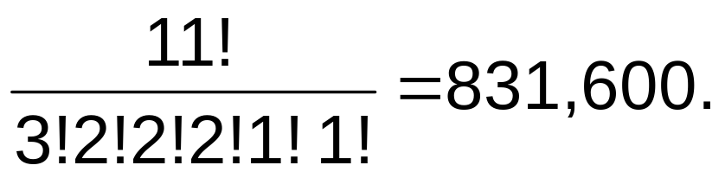
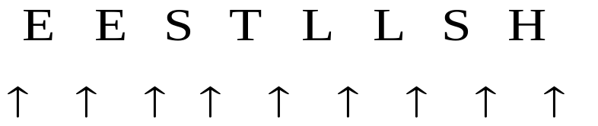
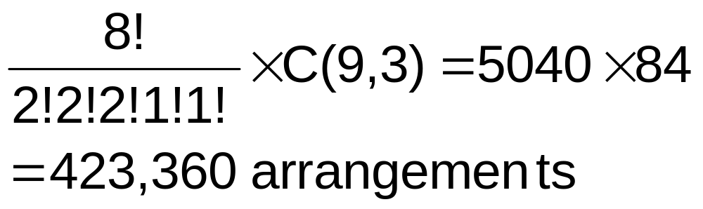
Arrangements and Combinations (1/2)
Example 1.23: The number of arrangements of the letters in TALLAHASSEE is
How many of these arrangement have no adjacent A’s?

Slide 22
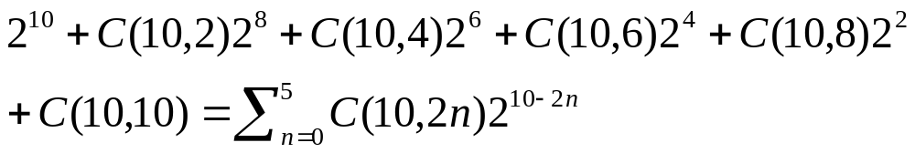
Arrangements and Combinations (2/2)
Example 1.24: Consider strings made up from symbols 0, 1, and 2. Suppose x = x₁x₂x₃ … x_{n} is one of strings of length n. We define the weight of x, denoted wt(x), by wt(x) = x₁ + x₂ + x₃ + … + x_{n}. Among the 3¹⁰ strings of length 10, we wish to determine how many have even weight. Such a string has even weight precisely when the number of 1’s in the string is even.

Slide 23
Overcounting (1/2)
Example 1.25:
a) Suppose that Ellen draws 5 cards from a standard deck of 52 cards. In how many ways can her selection result in a hand with no clubs?
C(39, 5)
b) Now suppose we want to count the number of Ellen’s 5-card selections that contain at least one club.
C(52, 5) – C(39, 5) = 2,023,303 vs.
C(13, 1)C(51, 4) = 3,248,700
Overcounting!
Notes:
Often we must be careful of overcounting – a situation that seems to arise in what may appear to be rather easy enumeration problems.
Club: (紙牌中的)梅花
b) 第二項 overcounting, 假設先選梅花3 之後選梅花5, 梅花K, 紅心7, 黑桃 J 與 先選梅花5 之後選梅花3, 梅花K, 紅心7, 黑桃 J 不該視為兩種不同的 selection

Slide 24
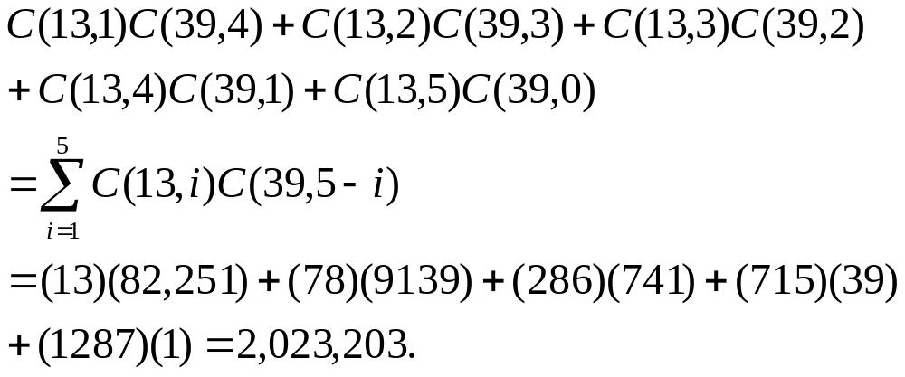
Overcounting (2/2)
Example 1.25 (cont.):
Another way to arrive at the answer:

Slide 25
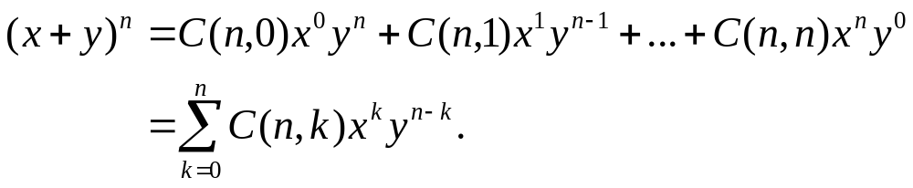
The Binomial Theorem (1/3)
Theorem 1.1 The Binomial Theorem. If x and y are variables and n is a positive integer, then
  There are C(n, k) different ways to select k x’s and n – k y’s from the n available factors.
  C(n, k) is often referred to as a binomial coefficient

Slide 26
The Binomial Theorem (2/3)
Example 1.26:
a) What is the coefficient of x⁵y² in the expansion of (x + y)⁷?
b) What is the coefficient of a⁵b² in the expansion of (2a – 3b )⁷?
a) C(7, 5) = 21
b) C(7, 5)(2)⁵(–3)² = 6048

Slide 27
The Binomial Theorem (3/3)
Corollary 1.1 For each integer n > 0,
a) C(n, 0) + C(n, 1) + … + C(n, n) = 2^{n}, and
b) C(n, 0) – C(n, 1) + … + (–1)^{n}C(n, n) = 0
Proof.
a) Set x = y = 1
b) Set x = –1, y = 1

Slide 28
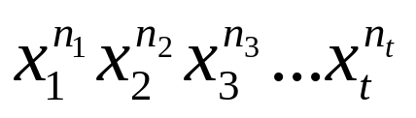
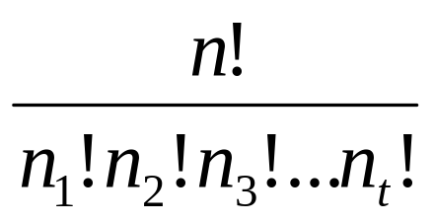
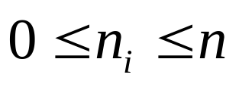

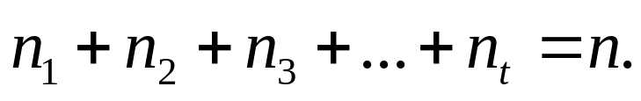
The Multinomial Theorem (1/3)
Theorem 1.2 The Multinomial Theorem. For positive integers n, t, the coefficient of
in the expansions of (x₁ + x₂ + … + x_{t})^{n} is
where each n_{i} is an integer with , for all
, and

Slide 29
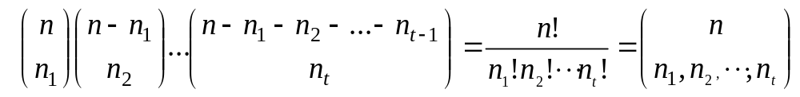
The Multinomial Theorem (2/3)
Proof of Theorem 1.2:
  The coefficient of is the number of ways we can select x₁ from n₁ of the n factors, x₂ from n₂ of the n – n₁ remaining factors, …
a multinomial coefficient

Slide 30
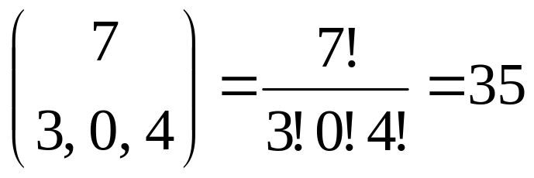
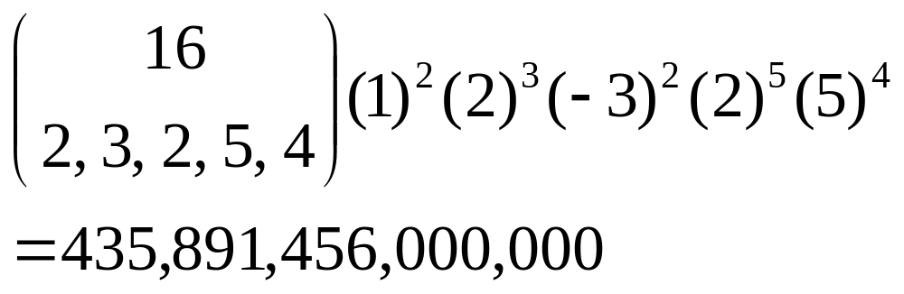
The Multinomial Theorem (3/3)
Example 1.27:
a) What is the coefficient of x³z⁴ in the expansion of (x + y + z)⁷?
b) What is the coefficient of a²b³c²d⁵ in the expansion of (a + 2b – 3c + 2d + 5)¹⁶?
a)
b)

Slide 31
Outline
The Rules of Sum and Product
Permutations
Combinations: The Binomial Theorem
Combinations with Repetition

Slide 32
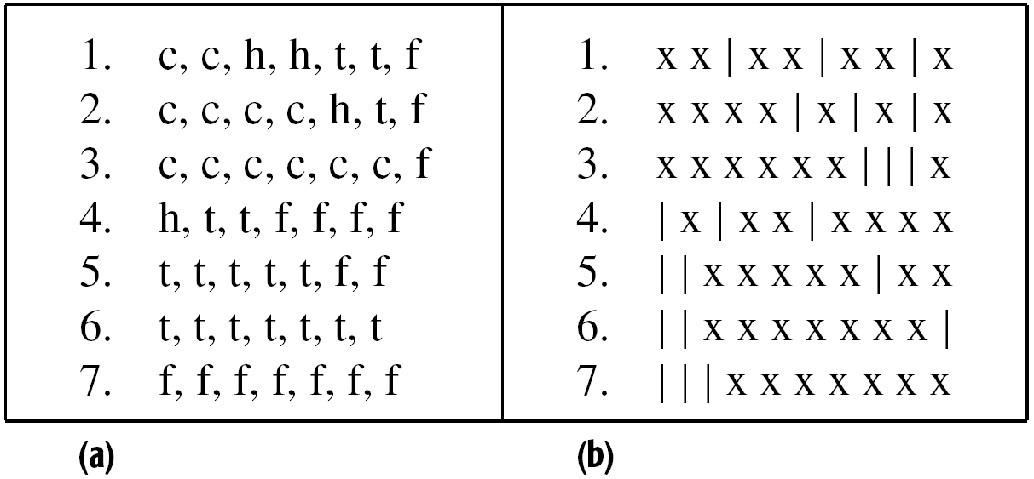
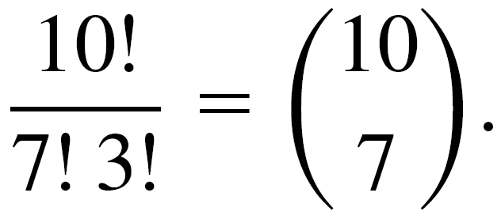
Combinations with Repetition (1/)
Example 1.28: 7 high school freshmen stop at a restaurant, where each of them has one of the following: a cheeseburger, a hot dog, a taco, or a fish sandwich. How many different purchases are possible (from the viewpoint of the restaurant)?
Notes:
Taco:炸玉米餅(或捲)
n^{r} 是排列, 從餐廳的觀點是組合

Slide 33
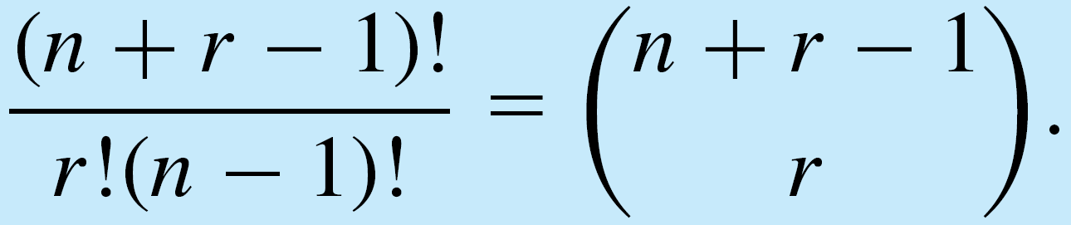
Combinations with Repetition (2/)
When we wish to select, with repetition, r of n distinct objects, we find that we are considering all arrangements of r x’s and n – 1 |’s and that their number is
Consequently, the number of combinations of n objects taken r at a time, with repetition, is
C(n + r – 1, r).
Notes:
Taco:炸玉米餅(或捲)
n^{r} 是排列, 從餐廳的觀點是組合

